Slide 1

MATRIX OPERATION SYSTEM
Object-Oriented Programming through C++
PBL PROJECT • REVIEW – 2
TEAM MEMBERS
PROJECT INSTRUCTOR
Sourav Dev • 25B11AI322 • AIML
Sushmita Roy • 25B11AIB54 • AIML
Tapas Das • 25B11AIB77 • AIML
N. AKHILA M.Tech (Ph.D)
Assistant Professor
AIML Department
Aditya University | AIML Department

Slide 2
Contents
1. Project Abstract
6. Architecture Diagram
2. Introduction
7. ER Diagram
3. Problem Statement & Objectives
8. Planning and Timeline Diagram
4. Users of the System
9. Role of Each Individual
5. Modules / Functionalities
9. Expected Outcome
PBL Course Name: Object Oriented Programming through C++ (2501CS08) REVIEW-1 2

Slide 3
Project Abstract
Project Overview
A C++ based Matrix Operation System that allows users to enter matrices and perform standard matrix calculations through a structured menu-driven interface.
Key Features
• Matrix input and validation
• Addition and subtraction
• Matrix multiplication
• Transpose, determinant and inverse
C++ / OOP Focus
• Matrix class and reusable methods
• Encapsulation and modular design
• Function-based operation handling
• Validation and error handling
PBL Course Name: Object Oriented Programming through C++ (2501CS08) REVIEW-1 3

Slide 4
Introduction
• Matrices are widely used in mathematics, computer science, engineering, graphics and artificial intelligence.
• Manual matrix calculations become lengthy and difficult to verify as matrix size increases.
• The proposed C++ application provides one organized interface for entering matrices and selecting operations.
• The design emphasizes accuracy, validation, modular programming and object-oriented principles.
PBL Course Name: Object Oriented Programming through C++ (2501CS08) REVIEW-1 4

Slide 5
Problem Statement & Objectives
Problem Statement
Manual matrix calculations are repetitive and may cause errors. Users need a simple C++ system that checks valid dimensions and performs multiple operations efficiently.
Objectives
• Perform common matrix operations
• Validate dimensions before calculation
• Reduce manual effort and errors
• Apply OOP concepts in C++
• Display results clearly
• Keep modules reusable and extendable
PBL Course Name: Object Oriented Programming through C++ (2501CS08) REVIEW-1 5

Slide 6
Users of the System
Students
Practice matrix concepts, solve assignments and verify programming outputs.
Faculty / Teachers
Demonstrate matrix operations and verify classroom or laboratory examples.
Developers / Learners
Learn C++ classes, matrix algorithms, validation and modular OOP design.
PBL Course Name: Object Oriented Programming through C++ (2501CS08) REVIEW-1 6

Slide 7
Modules / Functionalities
Matrix Class
Stores rows, columns and elements.
Input & Validation
Accepts input and checks valid dimensions.
Basic Operations
Addition and subtraction for compatible matrices.
Multiplication
Multiplies matrices when A.columns = B.rows.
Advanced Operations
Transpose, determinant and inverse.
Menu / Result
Selects operation and displays output.
PBL Course Name: Object Oriented Programming through C++ (2501CS08) REVIEW-1 7

Slide 8
Architecture Diagram
PRESENTATION LAYER
Console / Menu-driven User Interface
Input Matrix • Select Operation • Display Result
BUSINESS LOGIC LAYER
Matrix Manager | Operation Manager | Validation Manager
Controls operations, dimension checks and program flow
DATA / OBJECT LAYER
Matrix Objects | 2D Arrays / Vectors | Result Data
Stores matrix elements, dimensions and calculated results
Top → Bottom
PBL Course Name: Object Oriented Programming through C++ (2501CS08) REVIEW-1 8

Slide 9
ER Diagram
USER
CREATES
MATRIX
PROCESSES
OPERATION
1
N
1
N
user_id
matrix_id
columns
operation_id
name
rows
type
USER → creates MATRIX → processed by OPERATION → RESULT
PBL Course Name: Object Oriented Programming through C++ (2501CS08) REVIEW-1 9

Slide 10
Planning and Timeline Diagram
W1
W2
W3
W4
W5
W6
W7
Requirement Analysis
System Design (Class/ER Diagrams)
Coding & Module Development
Integration & Testing
Documentation & Final Review
Requirement Analysis → Design → Coding → Testing → Documentation
PBL Course Name: Object Oriented Programming through C++ (2501CS08) REVIEW-1 10

Slide 11
Role of Each Individual
Sourav Dev
Matrix class design, constructors and input handling
Sushmita Roy
Addition, subtraction and multiplication modules
Tapas Das
Determinant, inverse, validation, testing and debugging
Niloy Mallick
UI/menu design, diagrams, documentation and presentation
PBL Course Name: Object Oriented Programming through C++ (2501CS08) REVIEW-1 11

Slide 12
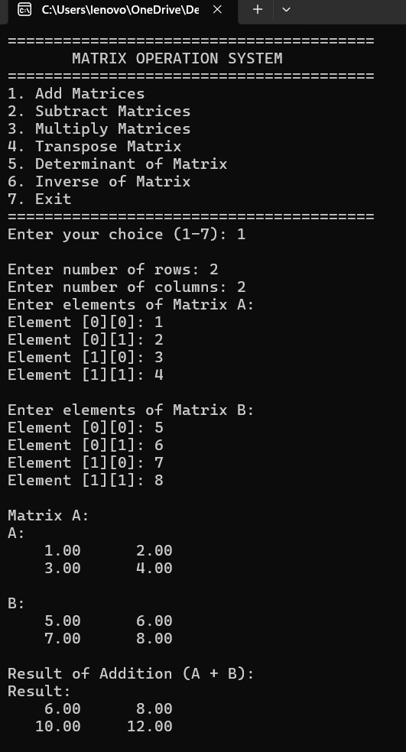
Expected Outcome
• A functional C++ Matrix Operation System with a clear menu-driven interface.
• Accurate results for supported matrix operations with proper dimension validation.
• Clean modular code demonstrating object-oriented programming concepts.
• The system can later be extended with GUI support, file storage and additional matrix operations.
THANK YOU
PBL Course Name: Object Oriented Programming through C++ (2501CS08) REVIEW-1 12

Slide 13
THANK YOU

